Slide 1
DATA MINING & MARKETING PROJECT : Online Retail
By Gotham Yallapu & Monish Pinapala

Slide 2


Introduction
Online retail, also known as e-commerce, refers to the buying and selling of goods and services over the internet. It has transformed the retail landscape by allowing consumers to shop from the convenience of their own homes or on the go through mobile devices.

Slide 3


Descriptive Analysis
OriginalDataset:
230,000 observations with 9 Variables
Final Dataset: 160,485 observations with 14 variables

Slide 4

Research Question
• What are the sales patterns, and how do they vary across different dimensions, including products/items, regions, and time intervals as well as other relevant factors?

Slide 5
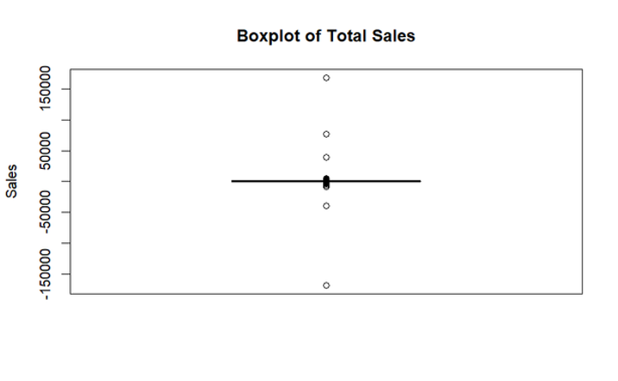
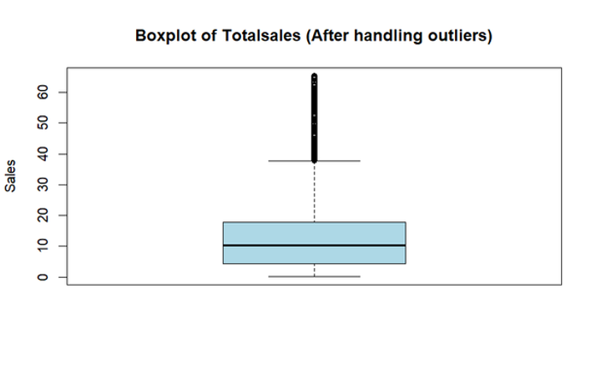
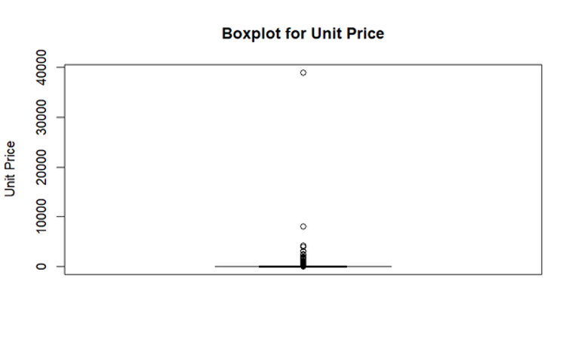
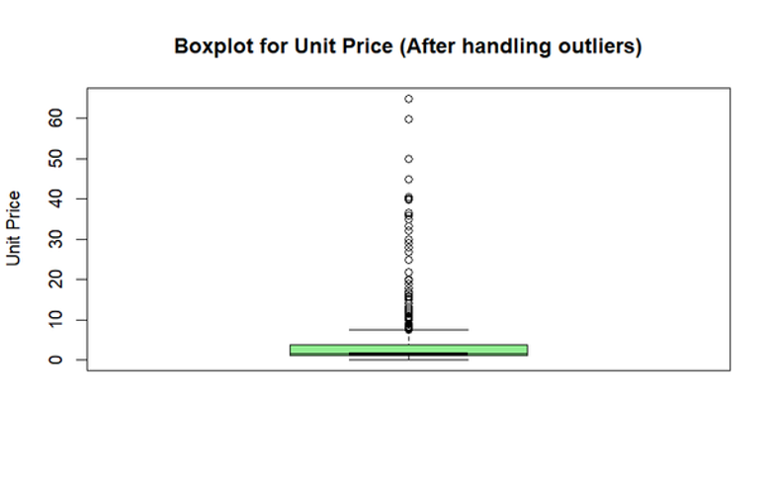
Data Visualizations

Slide 6
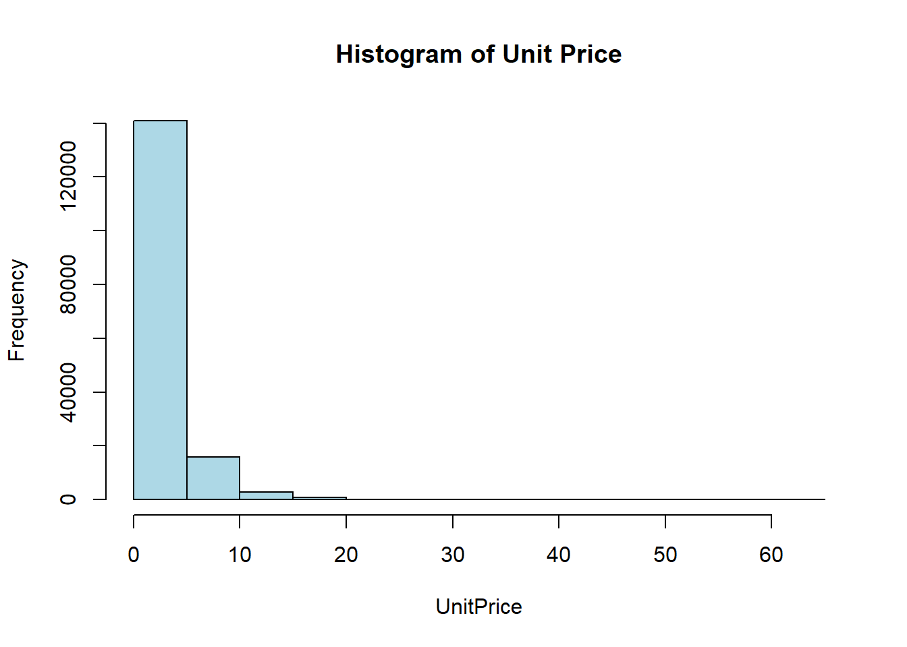
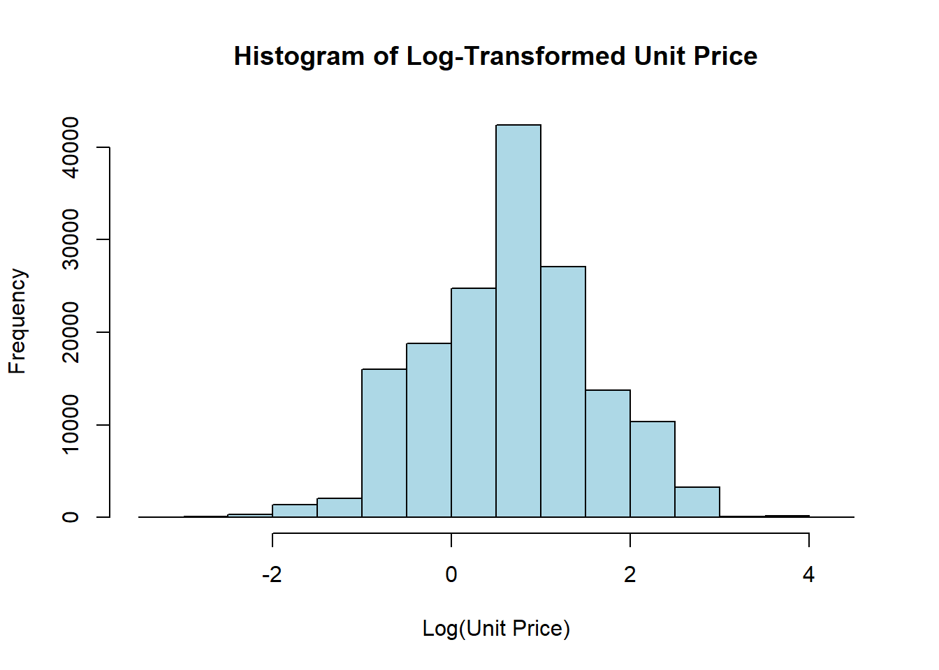

Data visualisations
New Variables created: GroupedCountry, Season, Customer frequency, item frequency, segments(HQLP-LQHP)

Slide 7
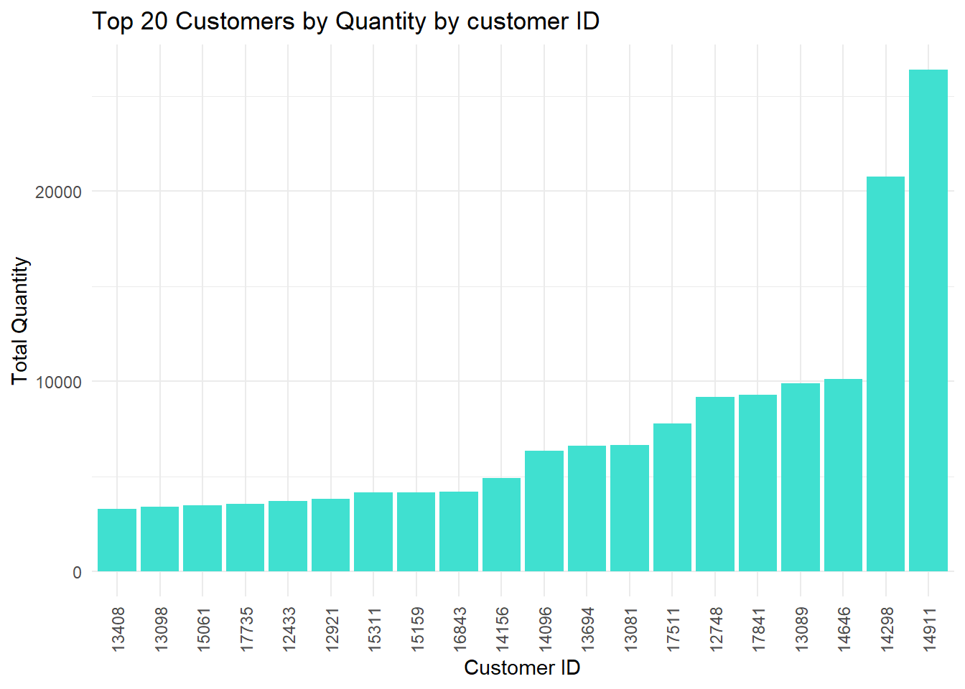
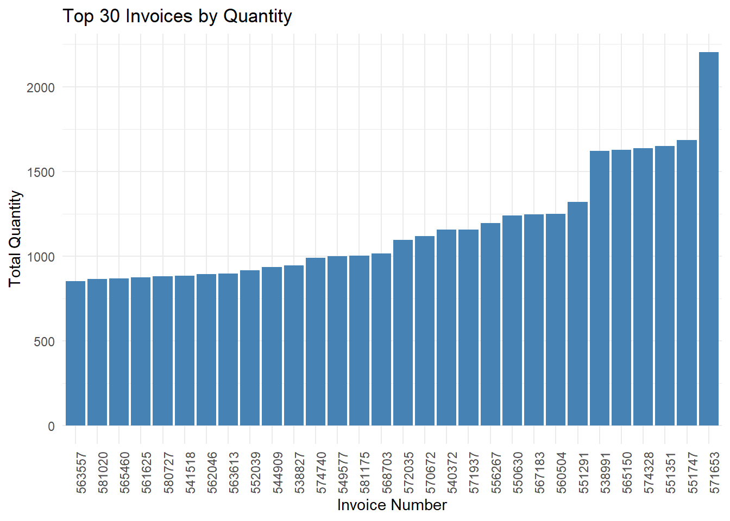

Slide 8
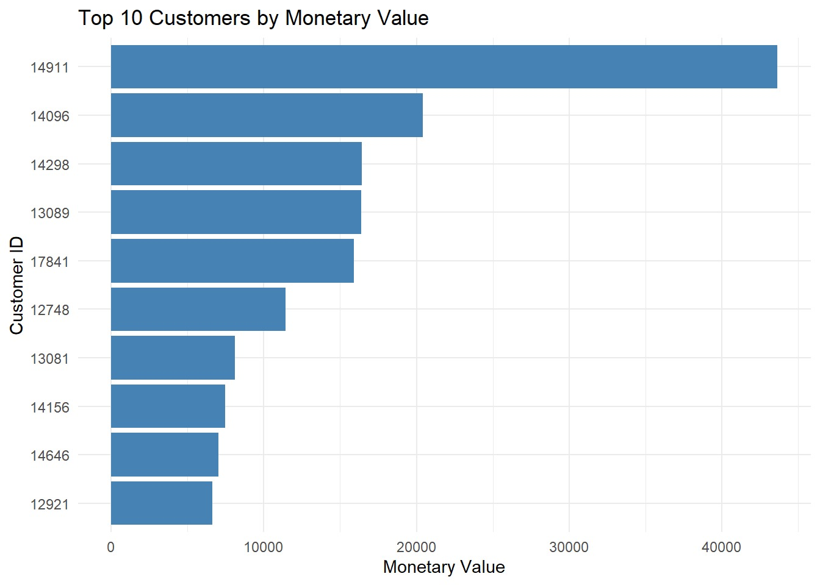
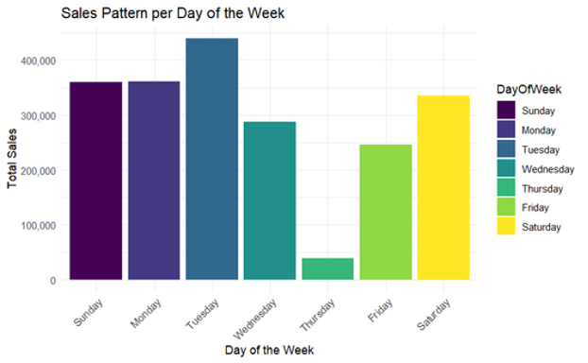
Marketing Perspective

Slide 9
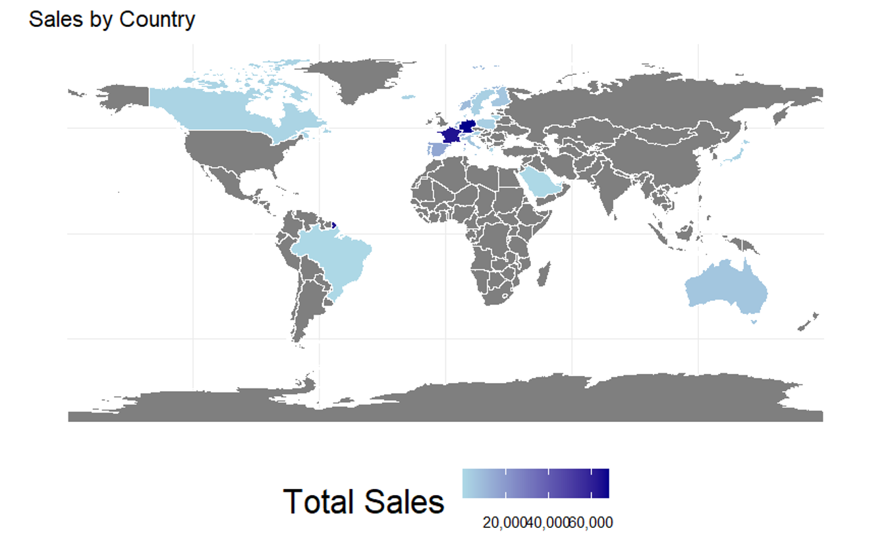

Slide 10
Model Results
Selected Model
Model | Multiple-Linear regression | Random Forest | Regression Tree
Variance Explained | 27.2 | 19.5 | 23.7
RMSE | 0.93 | 0.98 | 0.95

Slide 11
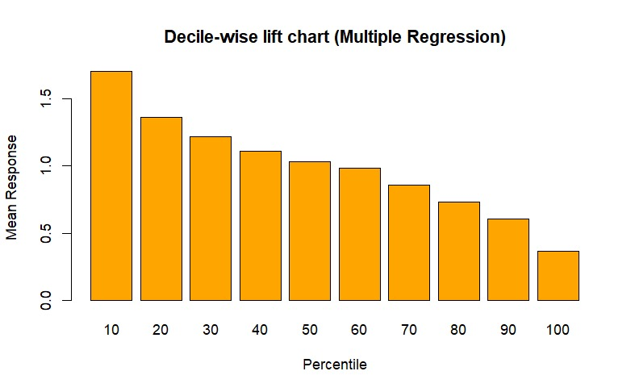
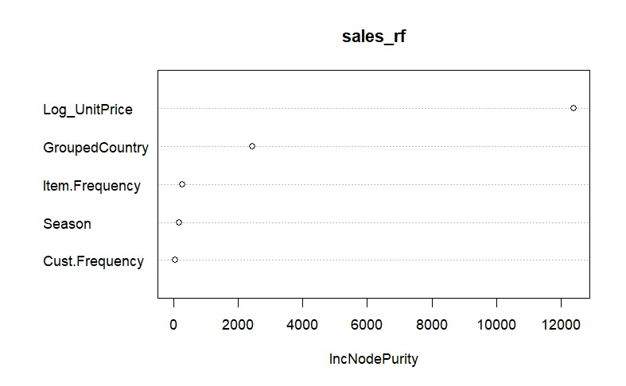
Model Results (Visualized)

Slide 12
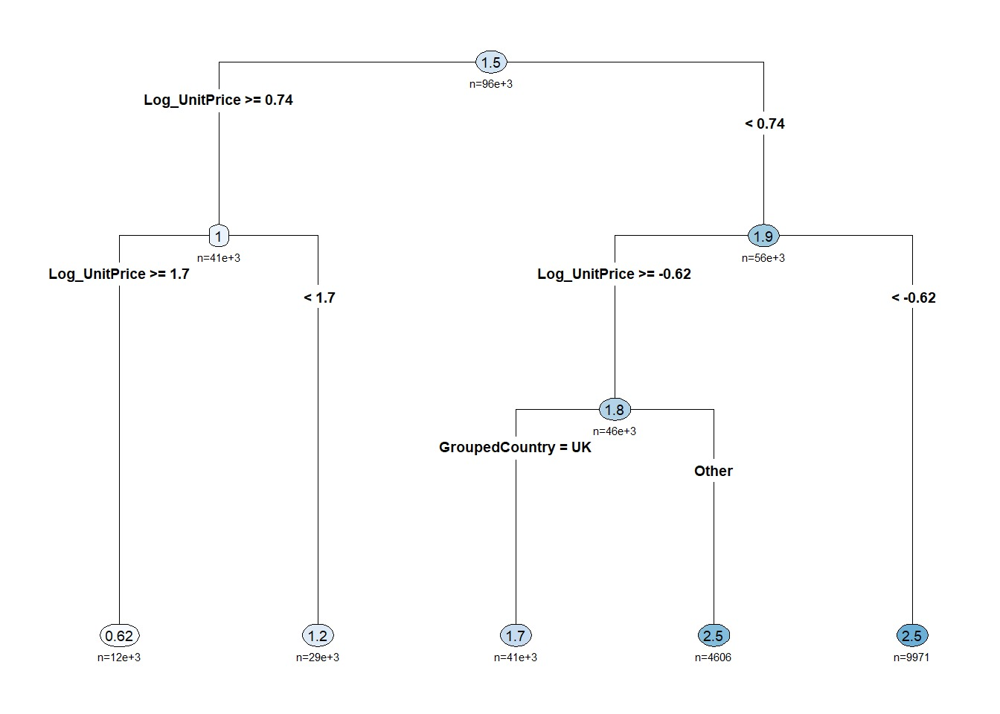
Model Results: Regression Tree

Slide 13
Conclusion
Dynamic Pricing
Seasonal Marketing
Loyalty & retention
Data-driven decision making
Regional Targeting

Slide 14

Thank You

Slide 15
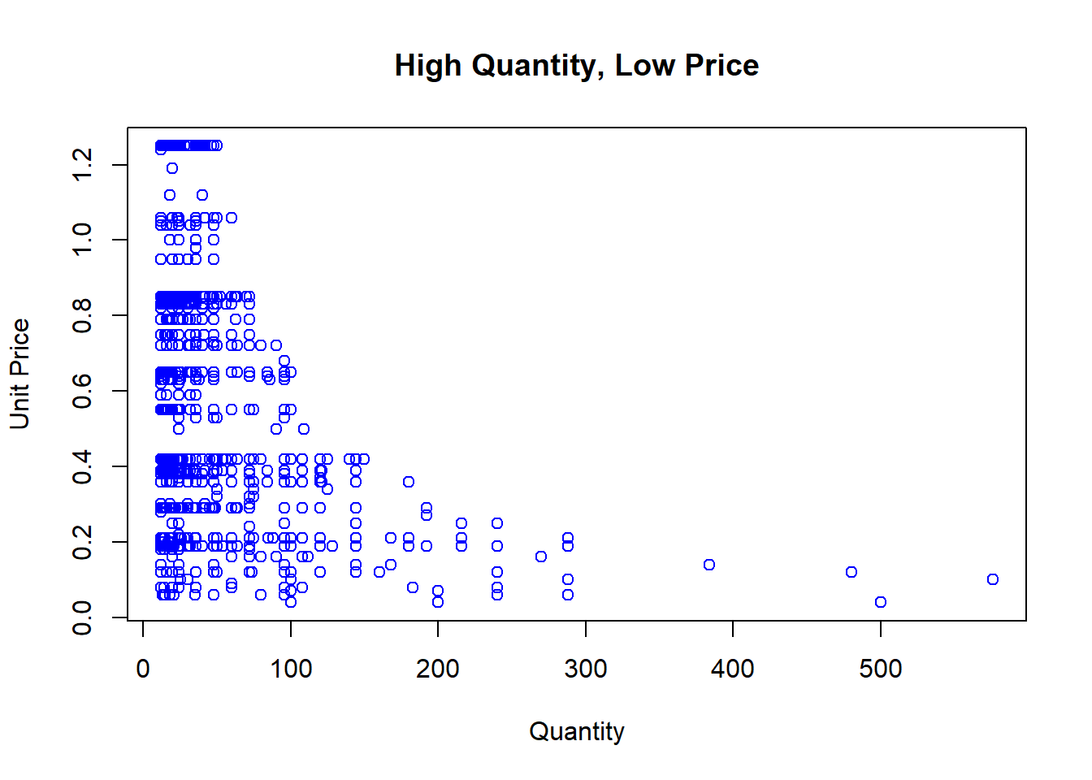
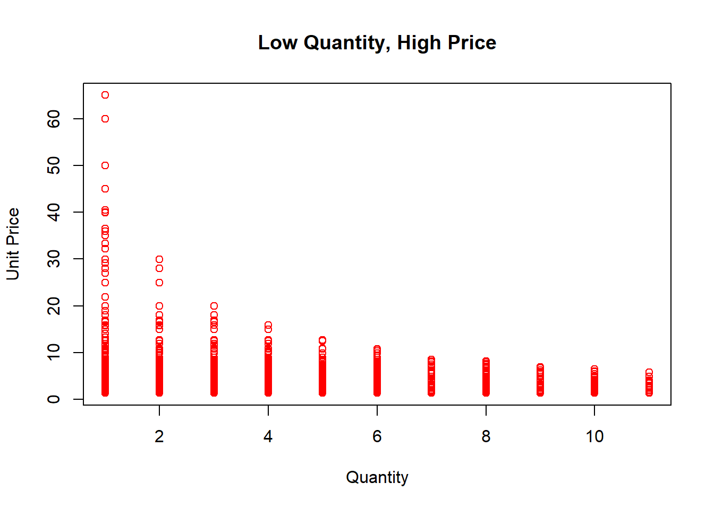
Appendix

Slide 16
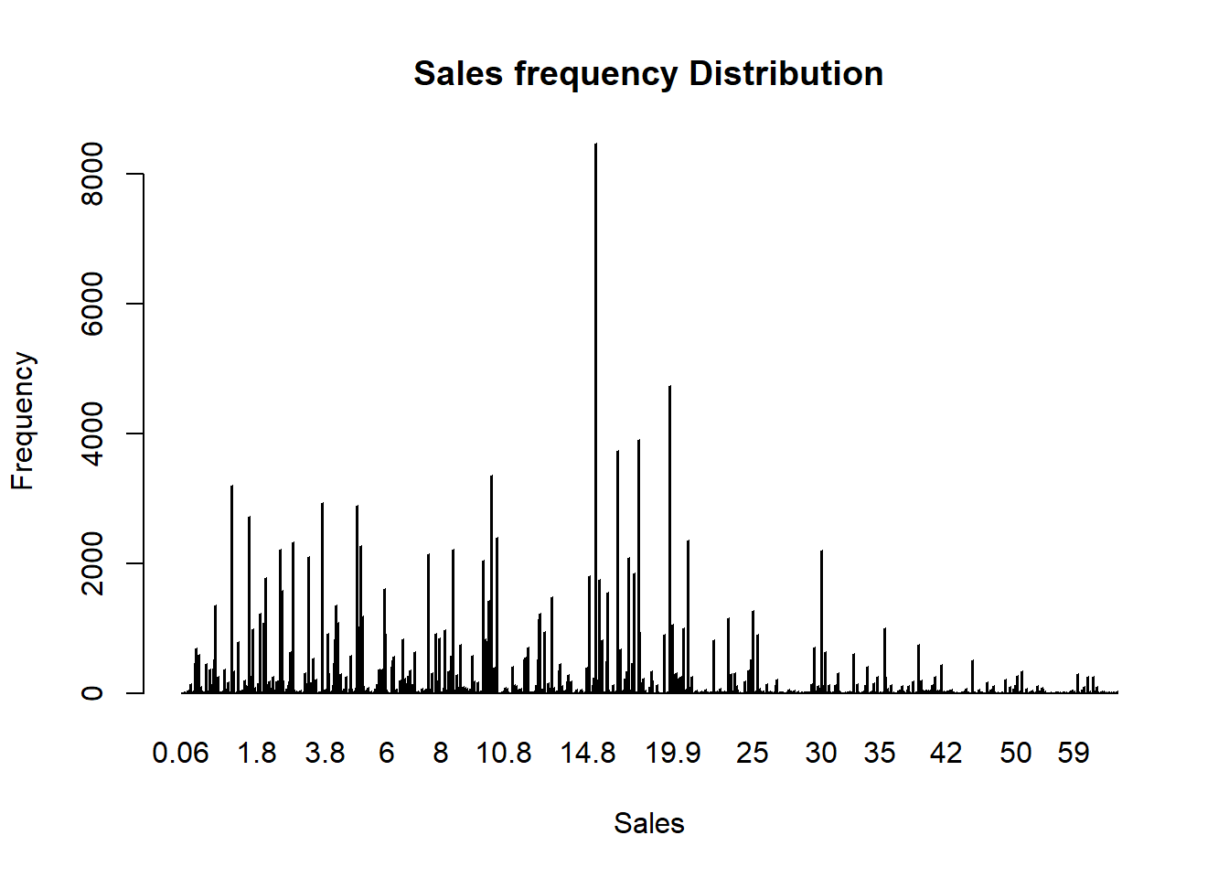
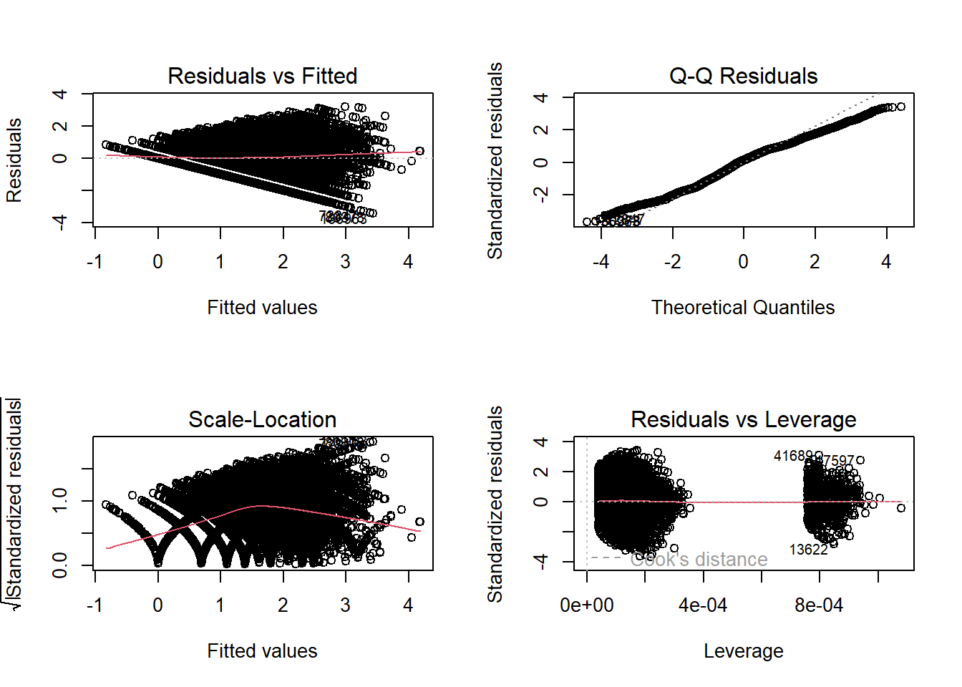
Appendix

